Slide 1
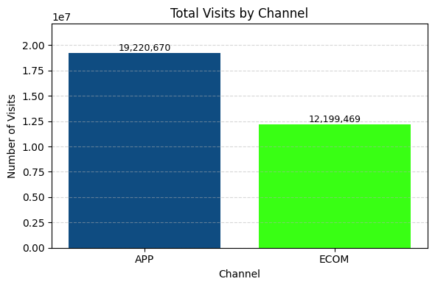
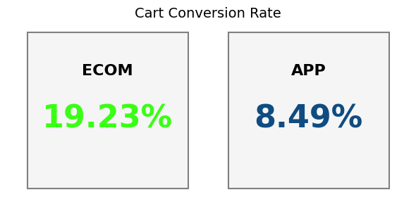
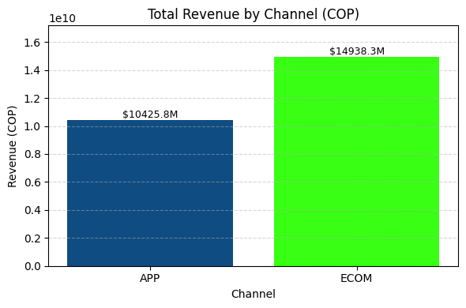
Evaluation of Sales Channel Performance in E-commerce for the Last Quarter of 2023:
Objetive: To provide an overview of the performance between APP and ECOM channels in terms of traffic, revenue, and conversion efficiency; analyze customer preferences by purchase channel and explore the types of products with the highest sales.
¿Which sales channel performed the best?
Although visits through the APP channel were 22% higher than those through the ECOM channel, revenues from ECOM were 18% higher than APP.
Additionally, the cart-to-sale conversion rate is significantly higher for ECOM, indicating better conversion efficiency..
In 2023, ECOM proved to be the best-performing sales channel, generating higher revenue and better conversion rates despite receiving fewer visits than APP.
Note: cart conversion rate and revenue calculations were based only on non-cancelled sales.
Ing. Joyce L. Cantillo Zuleta

Slide 2
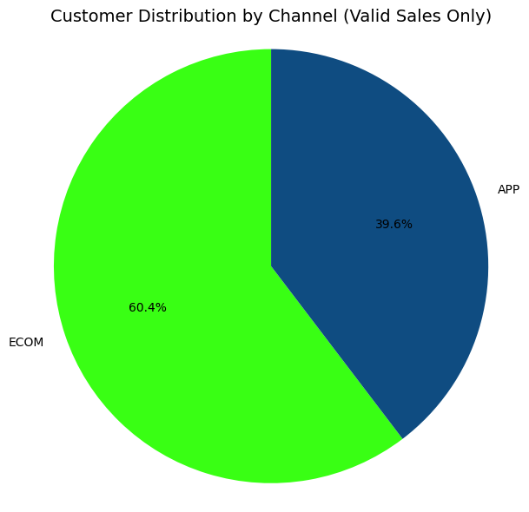
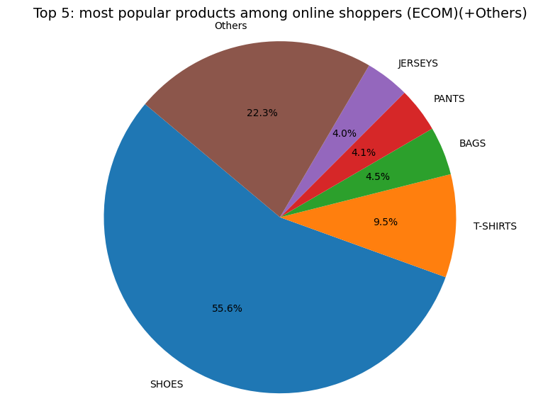
Which sales channel has the most customers, and what did they buy?
More customers made purchases through the ECOM channel — 20% more customers preferred ECOM over APP.
There was a 46% difference in sales between the top-selling product group, Shoes, and the second T-Shirts. (Note: "Other" corresponds to a grouping of many additional products, each accounting for less than 2% of total sales).
In 2023, ECOM attracted a larger customer base and concentrated sales in high-demand products like Shoes, indicating both a stronger channel preference and clearer purchase trends.
Note: All calculations were based only on non-cancelled sales.
Ing. Joyce L. Cantillo Zuleta

Slide 3

Strategic Takeaways & Recommendations
Key Findings:
The APP channel attracted more traffic, but ECOM generated higher revenue.
ECOM had a stronger cart-to-purchase conversion rate.
A greater percentage of customers purchased via ECOM, potentially due to a better shopping experience or clearer product offerings.
The star product on ECOM was Shoes, accounting for over half of the sales in this channel. This suggests a strong product-channel fit and highlights an opportunity to further capitalize on footwear demand through tailored promotions and targeted inventory.
Recommendations:
Optimize the APP channel: Improve UX/UI, simplify the checkout process, and highlight active promotions.
Leverage ECOM strengths: Focus on promoting top-selling products and design campaigns around detected customer behavior patterns.
Integrate multichannel strategies: Redirect traffic from the APP and social media platforms toward ECOM to capitalize on its higher conversion efficiency.
“Revenue, not visits, revealed where customers truly converted- and ECOM led the way in 2023.
Ing. Joyce L. Cantillo Zuleta

